Slide 1
計算物理
離散傅立葉轉換

Slide 2

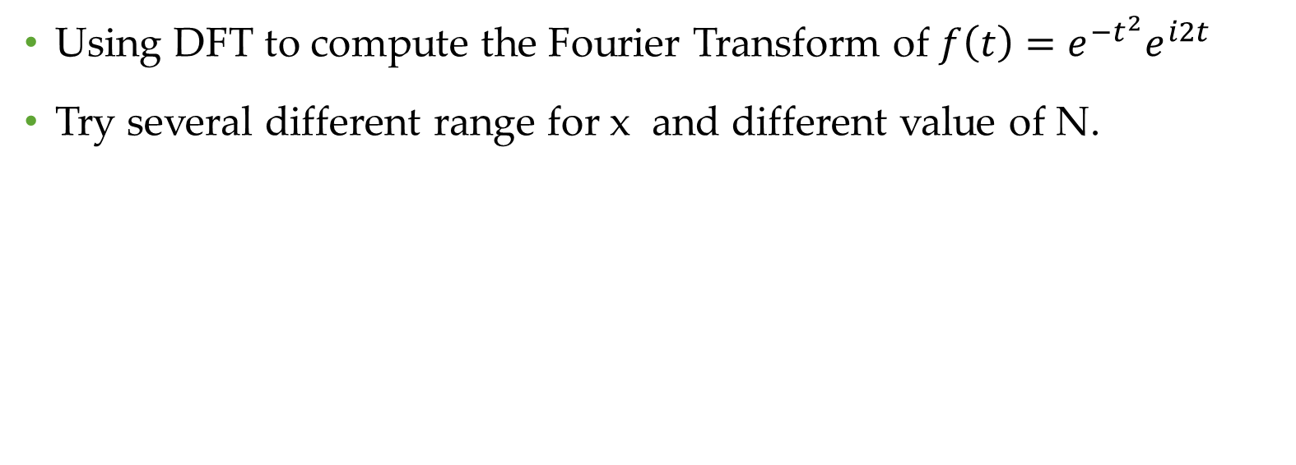
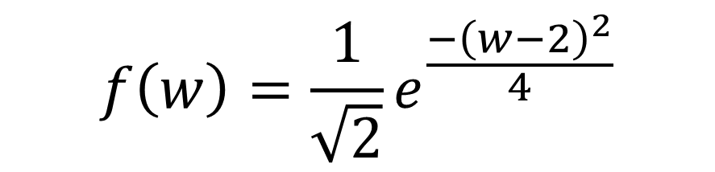
Problem
Using DFT to compute the Fourier Transform of $f\left(t\right)=e^{−t^{2}}e^{i2t}$
Try several different range for x and different value of N.
Fourier transform
$$f\left(w\right)=\frac{1}{\sqrt{2}}e^{\frac{−{\left(w−2\right)}^{2}}{4}}$$
$$f\left(x\right)=e^{−t^{2}}∙e^{2itx}$$

Slide 3
Fixed x
In the next few figures, I fixed the range of x into -7~7.
And I change N.

Slide 4
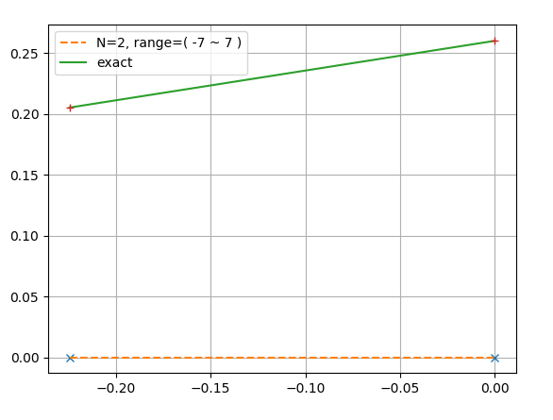
N=2

Slide 5
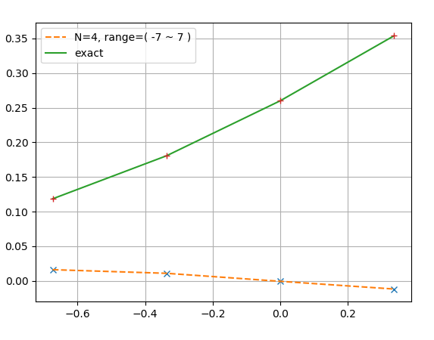
N=4

Slide 6
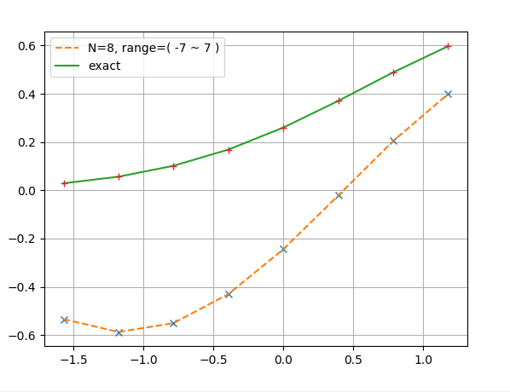
N=8

Slide 7
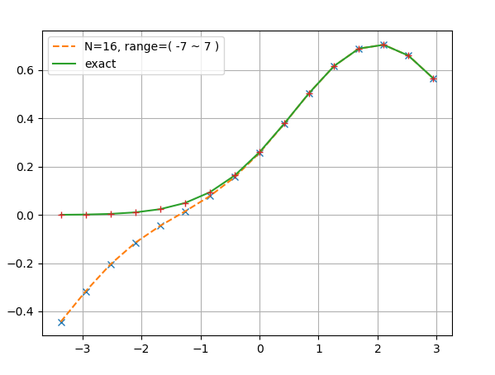
N=16

Slide 8
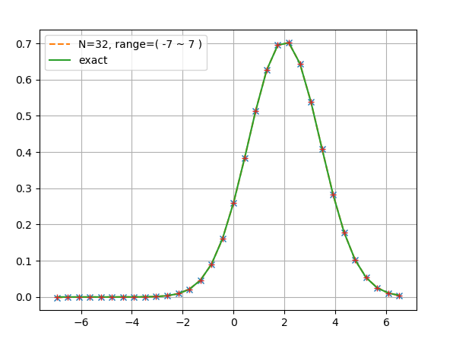
N=32

Slide 9
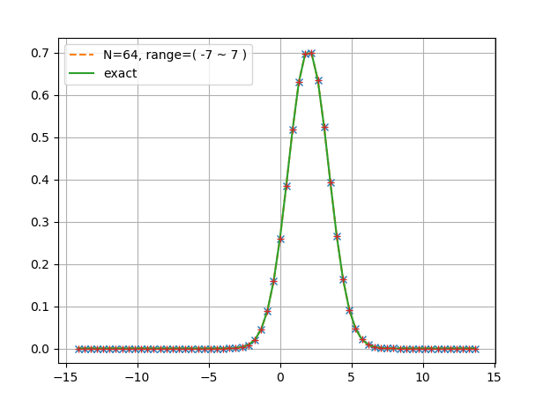
N=64

Slide 10
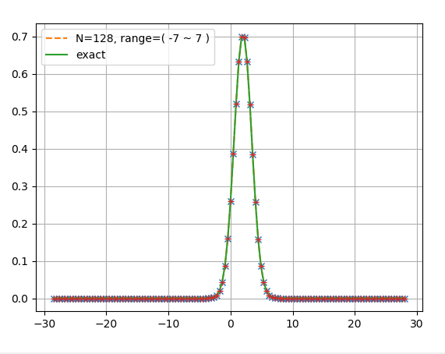
N=128

Slide 11
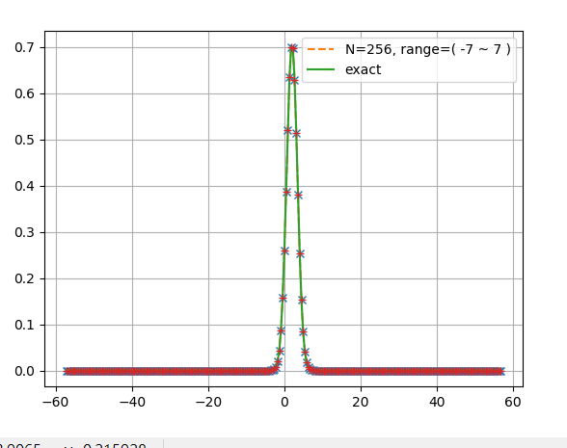
N=256

Slide 12
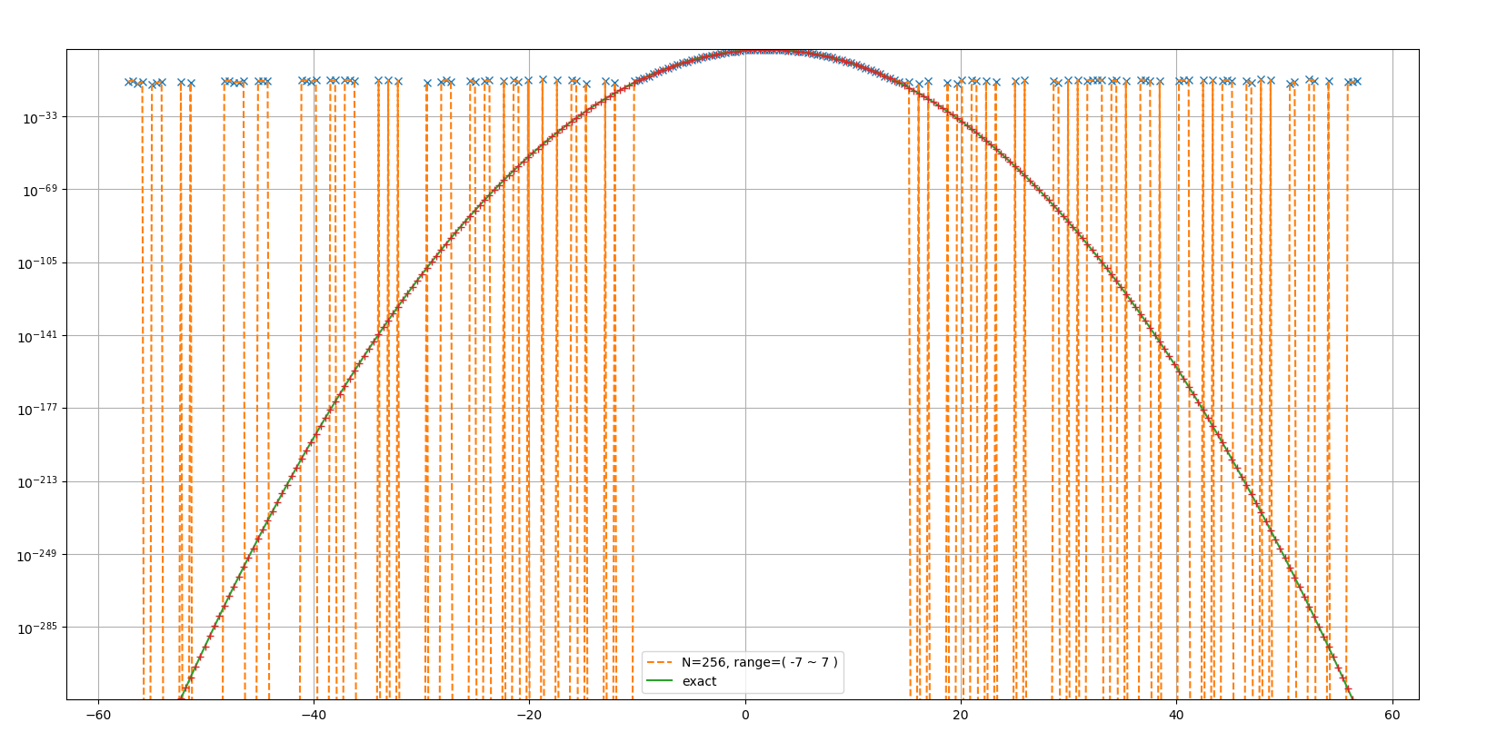
Logscale,N=256

Slide 13
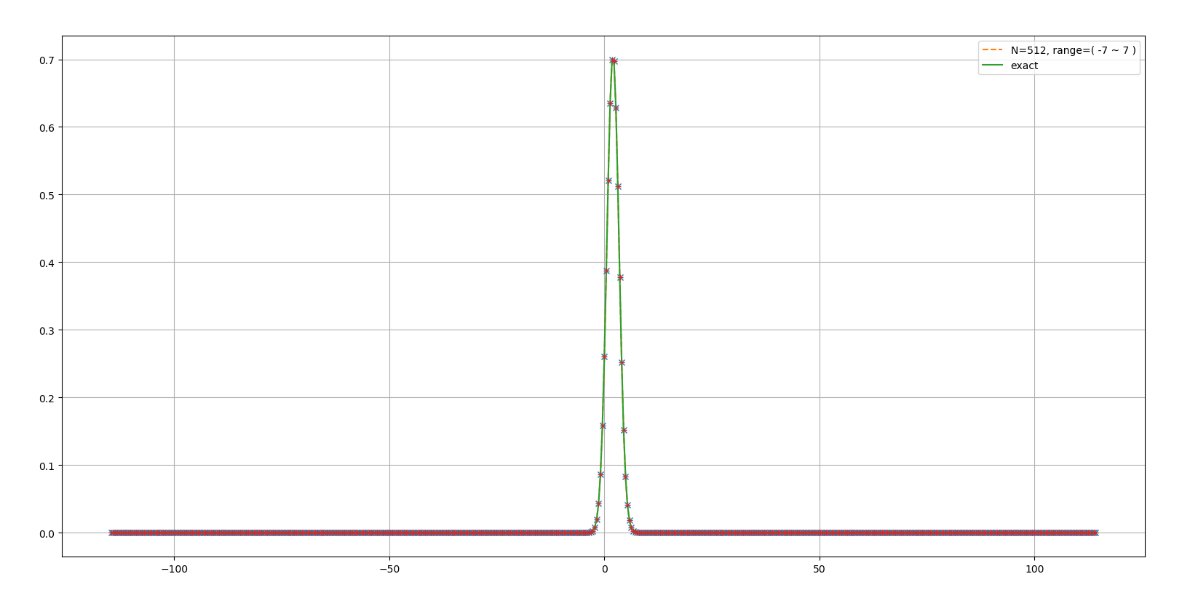
N=512

Slide 14
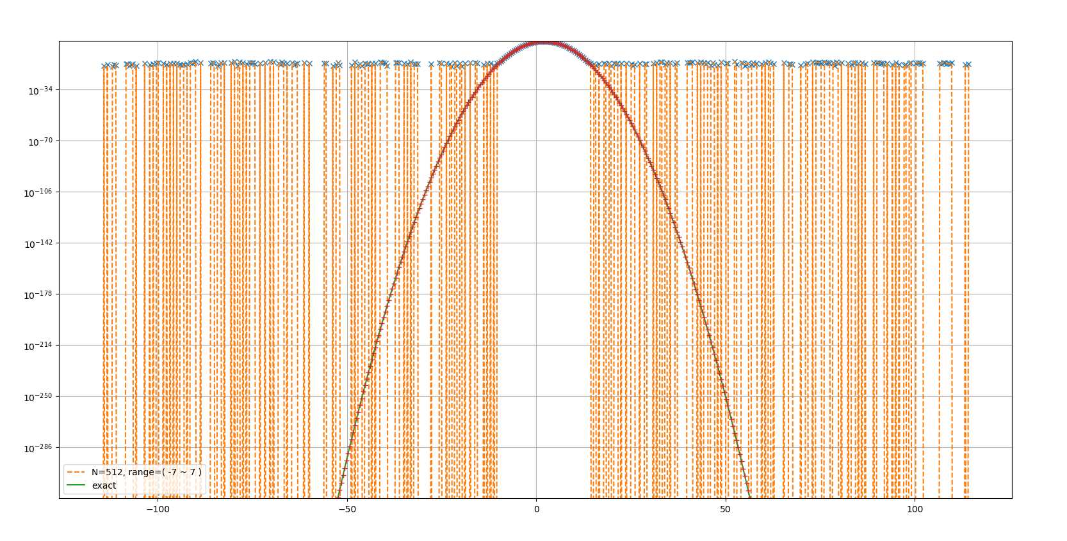
Logscale,N=512

Slide 15
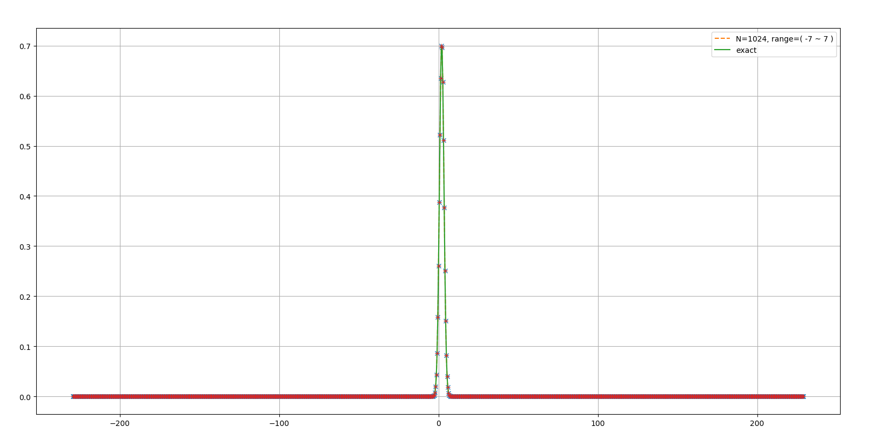
N=1024

Slide 16
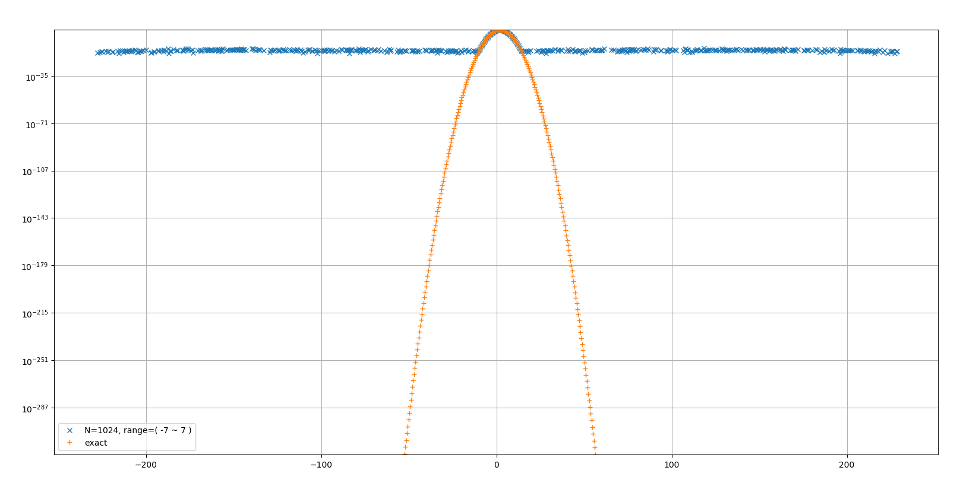
logscale,N=1024

Slide 17
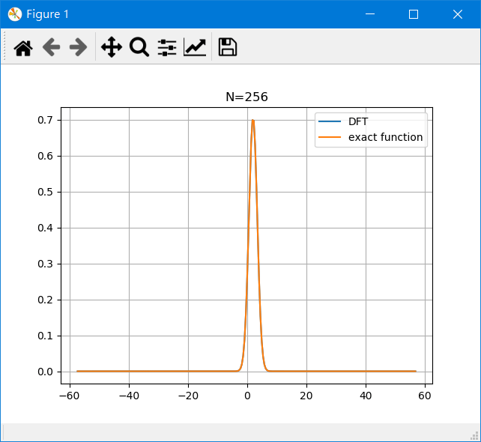
Gif

Slide 18
Fixed N
In the next few figures, I fixed N to 1024
And I change the range of x.

Slide 19
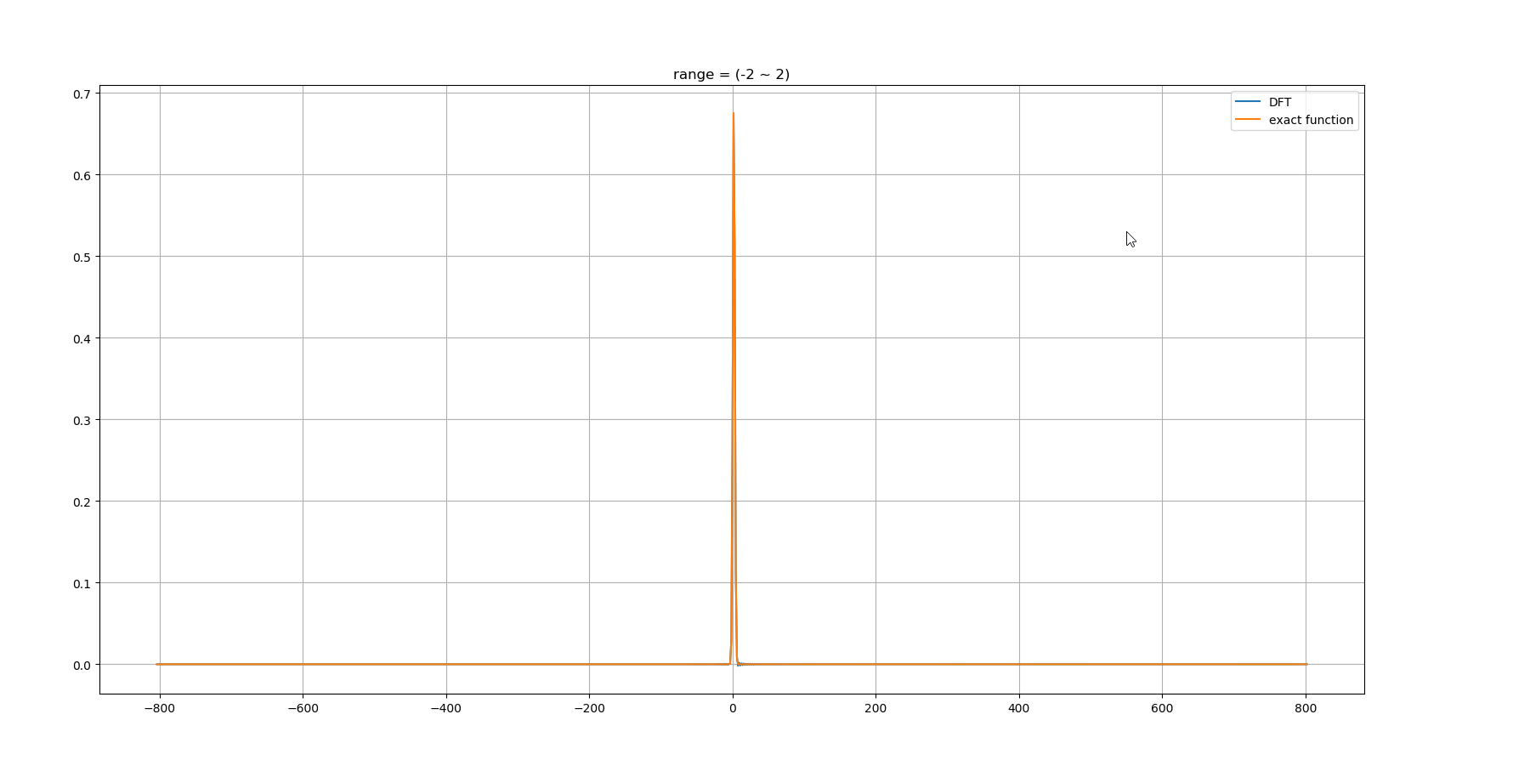

Slide 20
Summary
Fixed x
Fixed N
In Fixed x, the larger N we choose the smaller error we get.
In Fixed N, the larger range we choose the smaller range we get on spectrum space.

